Slide 1
On finding cohesive subgraphs
Ron Zeira
AGCT internal meeting
21.11.2012

Slide 2
Agenda
Computational background
Density
Cohesion
Finding a maximal cohesion subgraph
Find all close to maximal cohesive subgraphs
Simulation results

Slide 3
Background
Graph $G=(V,E)$
Nodes $V$
Edges $E⊆V×V$
Undirected
Directed
Edge weights $W:E→ℚ^{+}$
A path ${P=v}_{1},\left(v_{1},v_{2}\right),v_{2},…,v_{k−1},\left(v_{k−1},v_{k}\right),v_{k}$
Weight of a path $\sum_{e∈P}{W(e)}$

Slide 4
Flow networks
Flow network
Directed weighted graph
2 designated nodes $s$ and $t$
Weights are called capacities
An $s−t$ flow$f:E→$ $ℚ^{+}$
$∀e∈E 0≤f\left(e\right)≤W\left(e\right)$
$∀v∈V∖\{s,t\} \sum_{\left(u,v\right)∈E}{f\left(u,v\right)}=\sum_{\left(v,u\right)∈E}{f\left(v,u\right)}$
$F=\sum_{\left(s,v\right)∈E}{f\left(s,v\right)}−\sum_{\left(v,s\right)∈E}{f\left(v,s\right)}$

Slide 5
Cuts and flows
A $s−t$ cut $\left(S,T\right)$
$s∈S, t∈T$
$S∪T=V, S∩T=∅$
$C=\{e|e=\left(u,v\right)∈E, u∈S,v∈T\}$
$W\left(C\right)=\sum_{e∈E}{W(e)}$
Max-flow min-cut theorem. (Ford-Fulkerson, 1956): In any network, the value of max flow equals capacity of min cut.

Slide 6
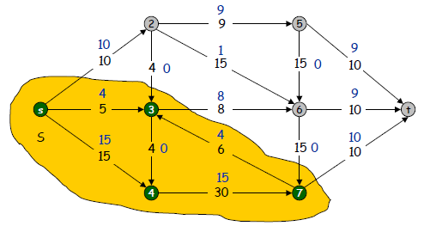
http://www.Princeton.EDU/~cos226
Notes:
Mistake: s to 4 should be 14

Slide 7
Ford & Fulkerson
Residual network (given a flow and a network)
Residual capacity $r\left(e\right)=w\left(e\right)−f(e)$
Update original edges with the residual capacity
Send backward edges with their flow
Theorem: Maximal flow iff no augmenting path
While there exist an augmenting path $P$
Find bottleneck capacity
Augment flow along $P$
Update residual graph

Slide 8
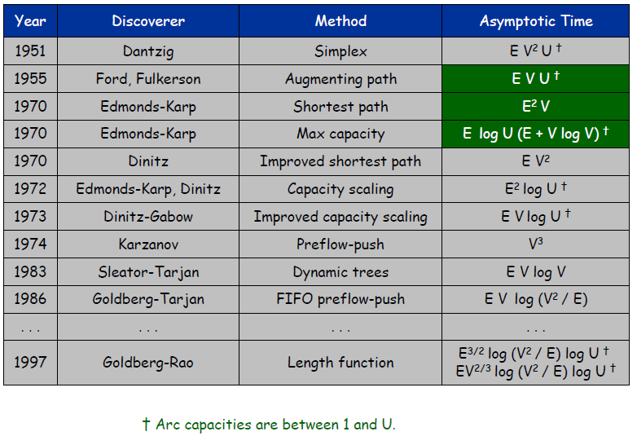
History of Worst-Case Running Times
http://www.Princeton.EDU/~cos226

Slide 9
Density
Goldberg ’84
Given an undirected graph $G=(V,E)$, density of a subgraph $S⊆V$ is defined as
$$d\left(S\right)=\frac{\left|E\left(S\right)\right|}{|S|}$$
where $E(S)$ is the set of edges in the subgraph induced by nodes in $S$.
Note that $2d(S)$ is simply the average degree of the subgraph induced by $S$.

Slide 10
Dense subgraphs problems
Given an undirected graph G=(V,E):
Find the densest subgraph.
Find the densest subgraph with exactly k vertices.
Find the densest subgraph with at least k vertices.
Find the densest subgraph with at most k vertices.
Notes:
Spoiler alert – complexity results

Slide 11
Maximum density subgraphs problem
Maximum density subgraph can be found in polynomial time for undirected graphs:
Combinatorial algorithms based on maxflow computations[Goldberg’84].
Linear programming based algorithm [Charikar’00].
Fast linear time algorithms for computing 2-approximate solutions [Kortsarz & Peleg’92, Charikar’00].

Slide 12
Densest k subgraph problem
NP hard.
Best approximation algorithm known: |V|^{1/3-ε} [Feige, Kortsarz, Peleg’93].
Best hardness result known: No PTAS exists [Khot’04].
Notes:
For k~V there is a constant approximation but not in the general case.
Explain approximation and PTAS (polynomial time approximation scheme)

Slide 13
Densest at least k subgraph problem
NP-Hard [Saha, Khuller’09].
3-approximation linear time greedy algorithm [Andersen,Chelapilla’08].
2-approximation combinatorial algorithm based on parametric flow computation [Saha, Khuller’09].
2-approximation LP rounding based algorithm [Saha, Khuller’09].

Slide 14
Densest at most k subgraph problem
NP-Hard.
A γ approximation algorithm for densest at most k subgraph problem implies a 4 γ approximation algorithm for the densest k subgraph problem [Saha, Khuller’09].

Slide 15
Cohesion
Density consider only the inner connectivity.
We would like a score that consider the separation.
$$D\left(S\right)=\frac{W\left(S\right)−βW\left(S,V∖S\right)}{\left|S\right|}$$

Slide 16
Cohesion cont.
Density is also susceptible to large subgraph.
For example: a graph with two $\frac{n}{2}$ cliques with $k>0$ edges between.
The cohesion of one clique in the graph is $\frac{\left(\begin{matrix}n/2 \\ 2\end{matrix}\right)−βk}{n/2}=\frac{n}{4}−\frac{1}{2}−\frac{2βk}{n}$
The cohesion of the entire graph $\frac{2\left(\begin{matrix}n/2 \\ 2\end{matrix}\right)}{n}=\frac{n}{4}−\frac{1}{2}$

Slide 17
Cohesion cont.
We would like to discourage the use of low degree nodes.
$$D\left(S\right)=\frac{W\left(S\right)−βW\left(S,V∖S\right)−γ\sum_{v∈S}{{\overline{d}}_{v}}}{\left|S\right|}$$
Where ${\overline{d}}_{v}$ is the complement degree of node $v$, defined as ${\overline{d}}_{v}=n−1−d_{v}$.

Slide 18
Max cohesion subgraph
The maximum cohesion subgraph problem seeks $\hat{S}=\underset{S⊆V}{argmax}{D(S)}$ .
Denote the maximal cohesion value $D^{∗}=D_{opt}=\max_{S⊆V}{D(S)}$ .
We show an algorithm finding the maximal density subgraph based on Goldberg’s methods.

Slide 19
Max cohesion algorithm
Let $g$ be a guess for $D^{∗}$. We construct a flow network $N(g)$ as follows.
$V_{N}=V∪\left\{s,t\right\}$
$E_{N}=\left\{\left(i,j\right),\left(j,i\right) | \left(i,j\right)∈E\right\}∪\left\{\left(s,i\right) | i∈V\right\}∪\left\{\left(i,t\right) | i∈V\right\}$
$C_{ij}=C_{ji}=\left(1+2β\right)w_{ij} ∀\left(i,j\right)∈E$
$C_{sj}=\tilde{m}−{2γ\overline{d}}_{j} ∀j∈V$
$C_{it}=\tilde{m}+2g−d_{i} ∀i∈V$

Slide 21
Algorithm cont.
$\tilde{m}=(β+2γ+\frac{1}{2})∗max⁡(\sum_{i∈V}{d_{i}}, \sum_{i∈V}{{\overline{d}}_{i}})$
We choose $\tilde{m}$ such that all capacities are positive. Notice that $g$ might be negative.
Let $\left(S,T\right)$ be an s-t cut in $N\left(g\right)$. Denote:
$V_{1}=S∖\{s\}⊆V$
$V_{2}=T∖\left\{t\right\}=V∖V_{1}$
$c\left(V_{1}\right)=c\left(S,T\right)=c\left(\left\{s\right\}⋃V_{1},\left\{t\right\}⋃\left(V∖V_{1}\right)\right)=\sum_{i∈S, j∈T}{c_{ij}}$

Slide 23
Theorem 1
THEOREM 1: For any $V_{1}⊆V$, $c\left(V_{1}\right)=C_{0}+2\left|V_{1}\right|(g−D(V_{1}))$. Where $C_{0}$ is a constant and $D(V_{1})$ is the cohesion of $V_{1}$.
PROOF .
If $V_{1}=∅$ , then $c\left(∅\right)=\tilde{m}\left|V\right|−2γ\sum_{i∈V}{{\overline{d}}_{i}}=C_{0}>0$.
O.W, $V_{1}≠∅$: $c\left(V_{1}\right)=\sum_{i∈S, j∈T}{c_{ij}}=$

Slide 24
Theorem 1 cont.
$$c\left(S,T\right)=\sum_{i∈S, j∈T}{c_{ij}}=$$
$$=\sum_{j∈V_{2}}{c_{sj}}+\sum_{i∈V_{1}}{c_{it}}+\sum_{i∈V_{1}, j∈V_{2}}{c_{ij}}=$$
$$=\left(\tilde{m}\left|V_{2}\right|−2γ\sum_{j∈V_{2}}{{\overline{d}}_{j}}\right)+\left(\tilde{m}\left|V_{1}\right|+2g\left|V_{1}\right|−\sum_{i∈V_{1}}{d_{i}}\right)+\left(\sum_{\begin{aligned}i∈V_{1}, j∈V_{2} \\ \left(i,j\right)∈E\end{aligned}}{\left(1+2β\right)w_{ij}}\right)=$$

Slide 25
Theorem 1 cont.
Since $\sum_{j∈V}{{\overline{d}}_{j}}=\sum_{j∈V_{1}}{{\overline{d}}_{j}}+\sum_{j∈V_{2}}{{\overline{d}}_{j}}$, rewriting the second term we get:
$$=\tilde{m}\left(\left|V_{1}\right|+\left|V_{2}\right|\right)−2γ\sum_{j∈V}{{\overline{d}}_{j}}+2γ\sum_{i∈V_{1}}{{\overline{d}}_{i}}+2g\left|V_{1}\right|−\sum_{i∈V_{1}}{d_{i}}+\sum_{\begin{aligned}i∈V_{1}, j∈V_{2} \\ \left(i,j\right)∈E\end{aligned}}{w_{ij}}+\sum_{\begin{aligned}i∈V_{1}, j∈V_{2} \\ \left(i,j\right)∈E\end{aligned}}{2βw_{ij}}$$

Slide 26
Theorem 1 cont.
$$=\left(\tilde{m}n−2γ\sum_{j∈V}{{\overline{d}}_{j}}\right)+2\left|V_{1}\right|\left(g−\left(\frac{{\left(\sum_{i∈V_{1}}{d_{i}−\sum_{i∈V_{1},j∈V_{2}}{w_{ij}}}\right)}/2−β\sum_{i∈V_{1},j∈V_{2}}{w_{ij} }−γ\sum_{i∈V_{1}}{{\overline{d}}_{i}}}{\left|V_{1}\right|}\right)\right)=$$

Slide 27
Theorem 1 cont.
$$=C_{0}+2\left|V_{1}\right|(g−D\left(V_{1}\right))$$
Where, $C_{0}=\tilde{m}n−2γ\sum_{j∈V}{{\overline{d}}_{j}}$
And,
$$D_{1}=D\left(V_{1}\right)=\frac{{\left(\sum_{i∈V_{1}}{d_{i}−\sum_{i∈V_{1},j∈V_{2}}{w_{ij}}}\right)}/{2−β\sum_{i∈V_{1},j∈V_{2}}{w_{ij} }−γ\sum_{i∈V_{1}}{{\overline{d}}_{i}}}}{\left|V_{1}\right|}=\frac{W\left(V_{1}\right)−βW\left(V_{1},V_{2}\right)−γ\sum_{v∈V_{1}}{{\overline{d}}_{v}}}{\left|V_{1}\right|}$$
$□$

Slide 28
Theorem 2
THEOREM 2 . Assume that $(S,T)$ is a minimum cut. If $V_{1}≠∅$, then, $g≤D^{∗}$; If $V_{1}=∅$ (i.e. $S=\{s\}$) then $g≥D^{∗}$ .
Proof
Notice $c\left(∅\right)=\tilde{m}n−2γ\sum_{j∈V}{{\overline{d}}_{j}}=C_{0}$.
For every min s-t cut we have $C_{0}≥c(S,T)$.
if $V_{1}≠∅$ → $2\left|V_{1}\right|\left(g−D_{1}\right)≤0$ →$g≤D_{1}≤D^{∗}$

Slide 29
Theorem 2 cont.
$V_{1}=∅$ → $c\left(∅\right)=\tilde{m}n−2γ\sum_{j∈V}{{\overline{d}}_{j}}=C_{0}$.
For any other $(\tilde{S},\tilde{T})$ → $\tilde{V_{1}}≠∅$ .
$(\tilde{S},\tilde{T})$ is not minimal → $c\left(\tilde{S},\tilde{T}\right)≥C_{0}$.
We get $C_{0}+2\left|\tilde{V_{1}}\right|\left(g−D\left(\tilde{V_{1}}\right)\right)≥C_{0}$→ $g≥D\left(\tilde{V_{1}}\right)$.
$g≥D\left(V_{1}^{∗}\right)=D^{∗}$

Slide 30
Bound the search
$$D^{∗}∈\left\{\frac{α}{n′} | −\frac{β}{2}\sum_{v∈V}{d_{v}}−γ\sum_{v∈V}{{\overline{d}}_{v}}≤α≤\frac{1}{2}\sum_{v∈V}{d_{v}} , 1≤n^{′}≤n\right\}$$
The difference $Δ$ between two possible value is
$$\left|Δ\right|=\left|\frac{α_{1}}{n_{1}}− \frac{α_{2}}{n_{2}}\right|=\frac{\left|α_{1}n_{2}−α_{2}n_{1}\right|}{n_{1}n_{2}}$$
$$n_{1}n_{2}≤n(n−1)$$
$$\left|α_{1}n_{2}−α_{2}n_{1}\right|≥\left|α_{1}−α_{2}\right|$$
↓
$$|Δ|≥\frac{\left|α_{1}−α_{2}\right|}{n(n−1)}$$

Slide 31
Bound the search cont.
Denote $δ$ the minimal difference between two edge weights:
$$δ=\left\{\begin{aligned}\min_{w_{e}≠w_{z}}\left|w_{e}−w_{z}\right|, &∃w_{e}≠w_{z} \\ 1, &o.w\end{aligned}\right.$$
The nominator difference, $\left|α_{1}−α_{2}\right|$, may be caused by at least two edges.
Difference may be affected by $β, γ$:
$f(β,γ)=\left\{\begin{aligned}min⁡(|β+γ|,\left|1−β−γ\right|), &0<|β+γ|<1 \\ min⁡(1,\left|1−β\right|,\left|1−γ\right|), &o.w\end{aligned}\right.$

Slide 32
Theorem 3
Therefore, $|Δ|≥\frac{δ∗f(β,γ)}{n(n−1)}$.
THEOREM 3 . If $G′$ is a subgraph of $G$ with cohesion $D′$, and no subgraph of $G$ has cohesion greater than or equal to$D^{′}+\frac{δ∗f(β,γ)}{n(n−1)}$ , then $G′$ is a maximum cohesion subgraph.

Slide 33
Max-cohesion-subgraph(G)
$l←−βW(V)−2γW(V)$;
$u←W(V)$;
$V_{1}←∅$;
while $u−l≥\frac{δ∗f\left(β,γ\right)}{n\left(n−1\right)}$ do
begin
$g←\frac{u−l}{2}$;
Construct $N(g)=(V_{N},E_{N})$;
$(S,T)←$Find min-cut $(N)$;
If $S=\{s\}$then $u←g$
else
begin
$l←g$;
$V_{1}←S∖\{s\}$;
end;
end;
return (subgraph of $G$ induced by $V1$)

Slide 34
Complexity
Loop: $\left\lceil log⁡\left((W\left(V\right)+βW\left(V\right)+2γ\overline{W}(V))\frac{n(n−1)}{δ∗f(β,γ)}\right)\right\rceil ≈log⁡(\frac{n∗\left(1+β+γ\right)∗w_{max}}{δ∗f(β,γ)}))$
If $w_{min} , w_{max} , β , γ$ are poly n: $O(logn)$.
The flow network has $O(n)$ nodes and $O(n+m)$ edges.

Slide 35
Number of cohesive subgraphs
Claim. There may be an exponential number of most cohesive graphs.
Proof. Graph with $n=k∗l$ nodes constructed form $l$ disjoint $k$ cliques.
Choose $1≤r≤l$ cliques
The density ($β=γ=0$):
$$\frac{r∗\left(\begin{matrix}k \\ 2\end{matrix}\right)}{r∗k}=\frac{k−1}{2}$$

Slide 36
Number of cohesive subgraphs
Overall $\sum_{r=1}^{l}{\left(\begin{matrix}l \\ r\end{matrix}\right)}=2^{l}−1$ subgraphs.
Conversely, take $k_{i}$ nodes from the i’th clique.
WLOG $k_{1}=\max_{i}{k_{i}}$. Density $\frac{k_{1}−1}{2}≤\frac{k−1}{2}$.
$\frac{k_{1}−1}{2}−\frac{\sum_{i}{\left(\begin{matrix}k_{i} \\ 2\end{matrix}\right)}}{\sum_{i}{k_{i}}}=\frac{\left(k_{1}−1\right)\sum_{i}{k_{i}}−\sum_{i}{\left(k_{i}−1\right)k_{i}}}{2\sum_{i}{k_{i}}}=\frac{\sum_{i}{\left(k_{1}−k_{i}\right)k_{i}}}{2\sum_{i}{k_{i}}}≥0$

Slide 37
Enumerate nearly cohesive subgraphs
A subgraph $S$ is $ε$ close to most cohesive if its cohesion is at least $D^{∗}(1−ε)$.
Given a graph $G=(V,E)$ and an $ε≥0$, we want to return $T_{ε}=\{S|S⊆V, D\left(S\right)≥\left(1−ε\right)D^{∗}\}$.
Reduce to finding close to minimal cuts using a method by Balcioglu & Wood.
Improve Saha and Kuller’s method.

Slide 38
Reduction
Find $D^{∗}$ and construct $N(D^{∗})$.
The value of a cut in $N(D^{∗})$ is
$$C_{0}+2\left|V_{1}\right|(D^{∗}−D\left(V_{1}\right))$$
LEMMA. Let $H_{ε}=\{V_{1}|c(V_{1})≤C_{0}+2\left|V_{1}\right|D^{∗}ε\}$, then $T_{ε}=H_{ε}$.

Slide 39
Proof
If $S^{′}∈T_{ε}$
${c\left(S^{′}\right)=C}_{0}+2\left|S^{′}\right|(D^{∗}−D\left(S′\right))$
$D\left(S′\right)≥\left(1−ε\right)D^{∗}$
$c\left(S^{′}\right)≤C_{0}+2\left|S^{′}\right|\left(D^{∗}−\left(1−ε\right)D^{∗}\right)=C_{0}+2\left|S^{′}\right|D^{∗}ε$ →$S^{′}∈H_{ε}$
If $S^{′}∈H_{ε}$
${c\left(S^{′}\right)=C}_{0}+2\left|S^{′}\right|\left(D^{∗}−D\left(S^{′}\right)\right)$
$c\left(S^{′}\right){≤C}_{0}+2\left|S′\right|D^{∗}ε$
$D\left(S′\right)≥\left(1−ε\right)D^{∗}$ → $S^{′}∈T_{ε}$

Slide 40
Enumeration process
Recursively enumerate over all cuts by constraining edges in or out.
$E^{+}$ is the set of edges included in the cut.
$E^{−}$ is the set of edges excluded out of the cut.

Slide 41
Halt condition
$E^{+}$ and $E^{−}$ are productive constraints if under $(E^{+},E^{−})$, $W\left(MinCut(G)\right)≤C_{0}+2\left|S\right|D^{∗}ε$.
LEMMA. If $(E^{+},E^{−})$ are not productive then there is no need to further enumerate cuts over supersets of $(E^{+},E^{−})$.
PROOF. Since $C$ is a non-productive minimum cut with $w\left(C\right)>C_{0}+2\left|S\right|D^{∗}ε.$ Any other cut $C′$ with constraints $E^{+}⊆{\tilde{E}}^{+},E^{−}⊆{\tilde{E}}^{−}$, will have $w\left(C^{′}\right)≥w(C)$ .

Slide 42
$$Enumerate\left(E^{+},E^{−}\right)$$
$w^{′}←w; N^{′}(D^{∗})←N(D^{∗});$
for ( each edge $e=\left(u,v\right)∈E^{−}$) $w^{′}\left(u,v\right)←∞$;
for ( each edge $e=\left(u,v\right)∈E^{+}$) begin
$w^{′}\left(s,u\right)←∞$;
$w^{′}\left(v,t\right)←∞$;
endfor;
${({\left\{s\right\}∪S}^{′},\{t\}∪T^{′},C}^{′})←MinCut(N^{′}(D^{∗}))$;
If ($w^{′}\left(C^{′}\right)>C_{0}+2\left|S^{′}\right|D^{∗}ε$) return;
$M←M∪S′$;
for ( each edge $e∈(C^{′}∖E^{+})$) begin
$E^{−}←E^{−}∪\left\{e\right\}$;
$Enumerate\left(E^{+},E^{−}\right)$;
$E^{−}←E^{−}∖\left\{e\right\}$;
$E^{+}←E^{+}∪\left\{e\right\}$;
endfor;
return $M$;

Slide 43
Complexity
The number of leaves in each non-terminal stage is $m$.
THEOREM. Finding each maximum cohesion SG ($ε=0$) takes $O\left(m^{2}\right)$.
Proof:
Weights are only increased in each stage → flow still feasible.
Maximal flow iff no augmenting path.
Finding augmenting path with BFS $O(m)$.

Slide 44
Complexity cont.
For a general $ε>0$ we can’t bound the number of augmentations (?).
$O(mM\left(n,m\right))$ for each solution and $O(mM\left(n,m\right)|T_{ε}|)$ for the entire enumeration.

Slide 45
Contaminated clique model
Random corrupted clique graph model similar to Ben-Dor et al.
Start with a graph $G$ composed from several disjoint cliques.
Flip each edge/non-edge with probability $0≤p<\frac{1}{2}$.

Slide 47
Tests
Random contaminated graph model with structure$S=\left(0.4,0.3,0.2,0.1\right)$.
$n=200$
Density ($β=γ=0)$ vs. cohesion ($β=0,γ=0.5$).
Quality assessment using Jaccard.

Slide 48
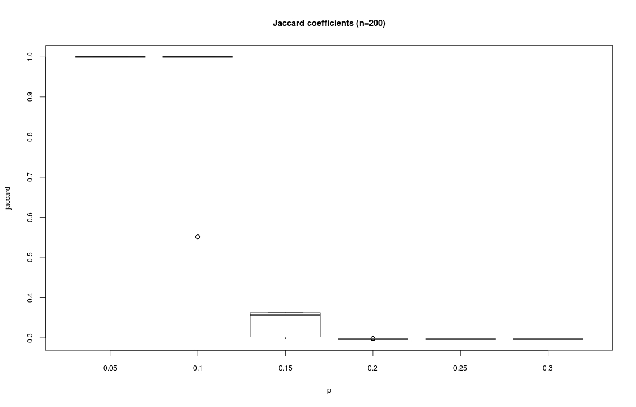
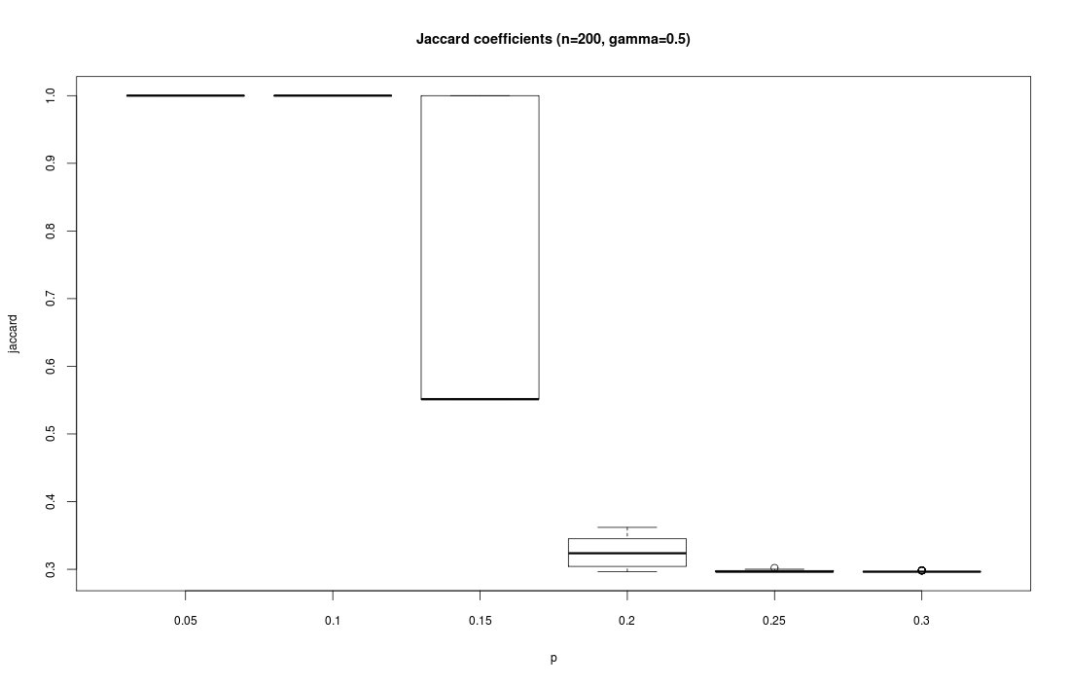
Notes:
Jaccard coefficients for different values of contamination. The left figure present results for $β=γ=0$ and the right for $γ=0.5$. Both versions decompose the graph perfectly for $p≤0.1$. for $p=0.15$ we see that the density definition deteriorate with values around 0.36 corresponding to just finding the 0.1 cluster and the rest of the graph. On the other hand, for $γ=0.5$, Jaccard values are either 1 (perfect match) or 0.55 corresponding to finding the 0.1 and 0.2 clusters and puting 0.3 and 0.4 together. The original density definition clusters the whole graph together (J=0.29) for $p≥0.2$. The cohesion version finds the 0.1 cluster in some of the cases of $p=0.2$ before failing to identify any clusters for greater values.

Slide 49
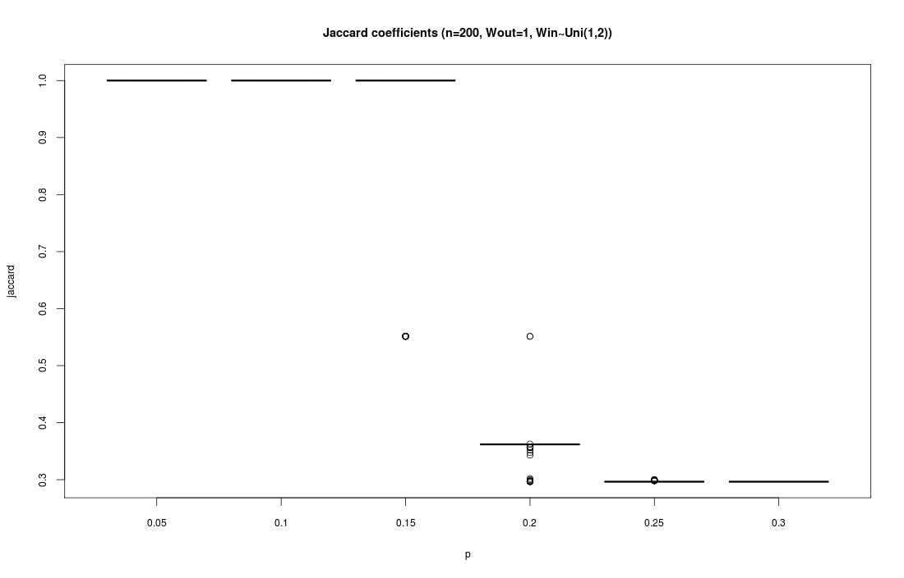
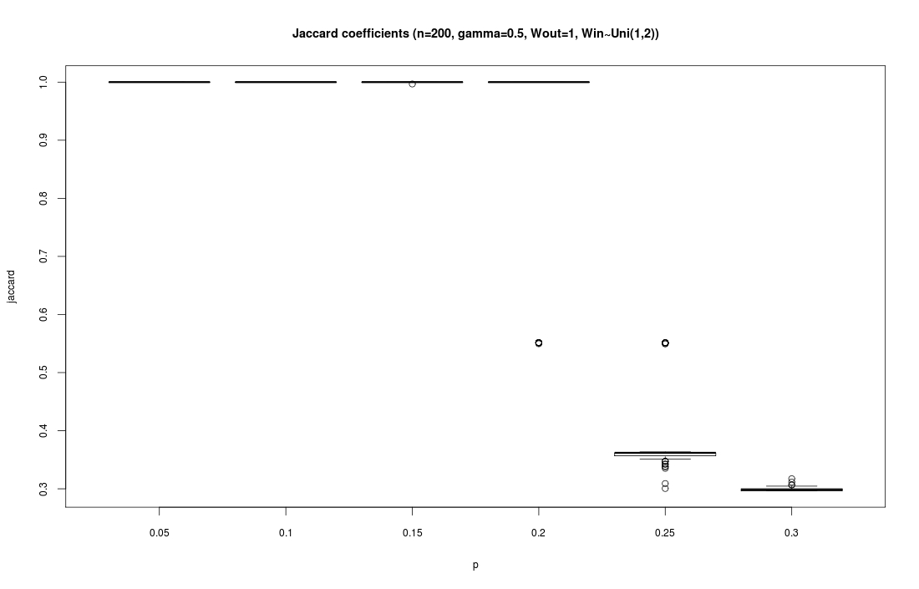
$$w_{out}=1$$
$$w_{in}\sim U(1,2)$$
Notes:
Jaccard coefficients for different values of contamination on graphs with $w_{in}\sim U(1,2)$ and $w_{out}\sim U(1,1)$. The left figure present results for $β=γ=0$ and the right for $γ=0.5$. As expected, the problem was alleviated in comparison to the unweighted graphs. Both version cluster perfectly for $p≤0.15$. The cohesion version can handle $p=0.2$ while the density can only find the 0.1 cluster in the same contamination. For $p=0.25$ density cannot detect any cluster while the 0.1 cluster can be could using cohesion. Both versions cannot handle $p=0.3$.

Slide 50
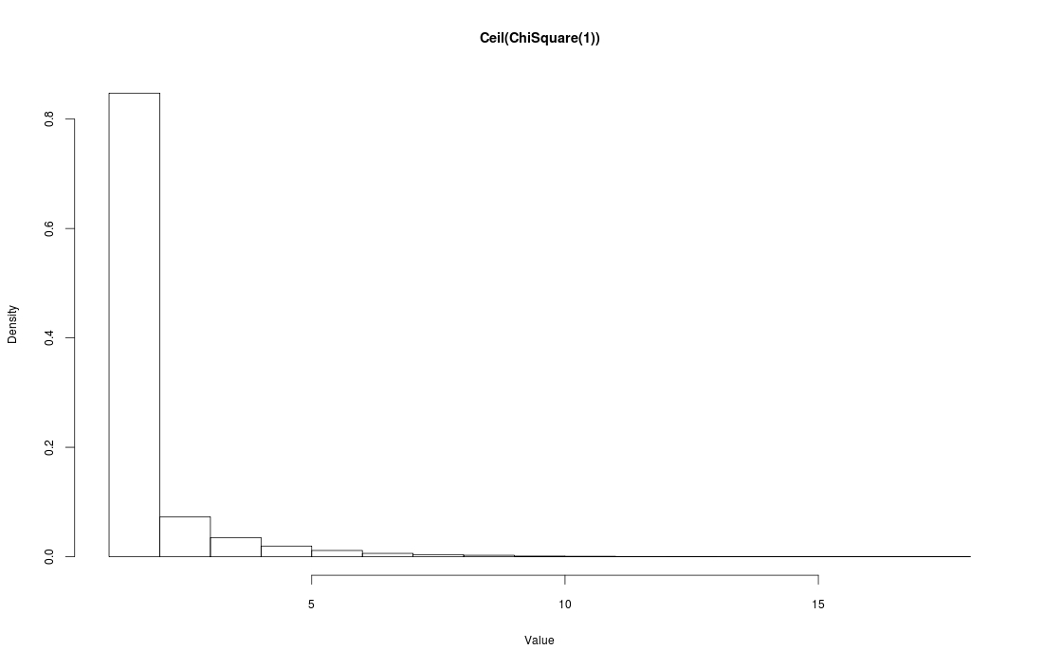
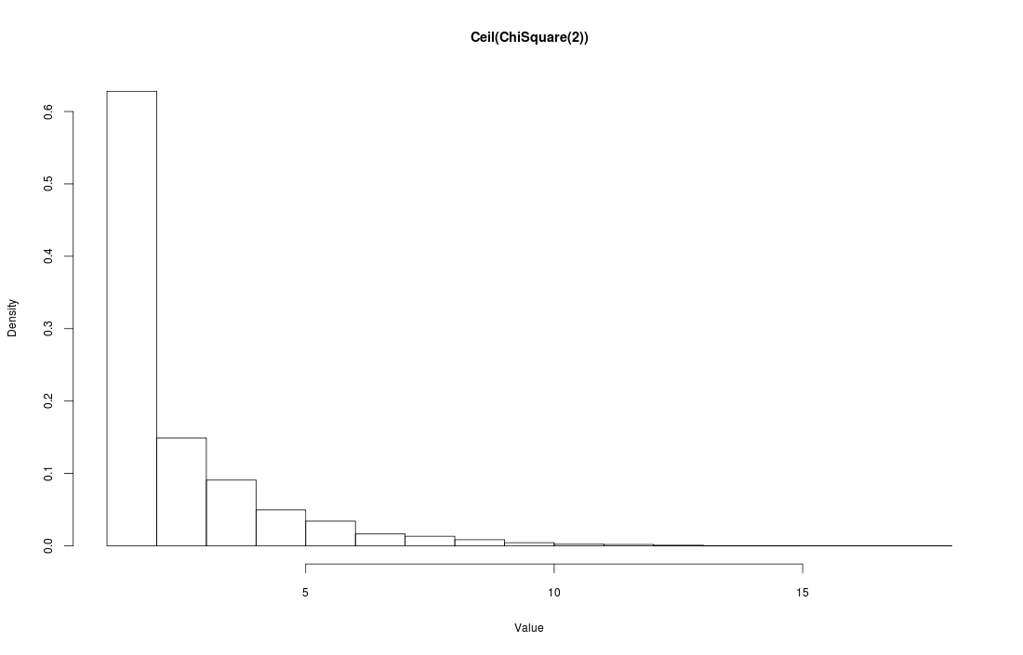
$$\left\lceil χ_{1}^{2}\right\rceil$$
$$\left\lceil χ_{2}^{2}\right\rceil$$
Notes:
Discrete Chi-square distribution $\left\lceil χ^{2}\right\rceil$ for 1 and 2 degrees of freedom. For $\left\lceil χ_{1}^{2}\right\rceil$, 85% of values are 1 and the rest a tailing up to 15. For $\left\lceil χ_{2}^{2}\right\rceil$, only 63% of values are 1.

Slide 51
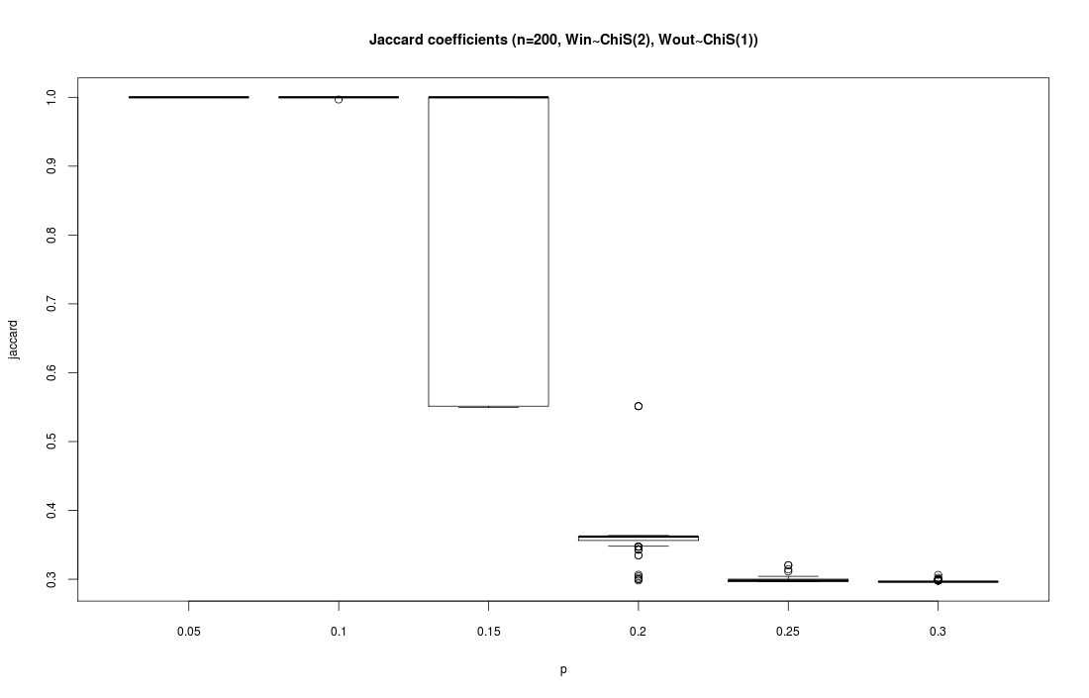
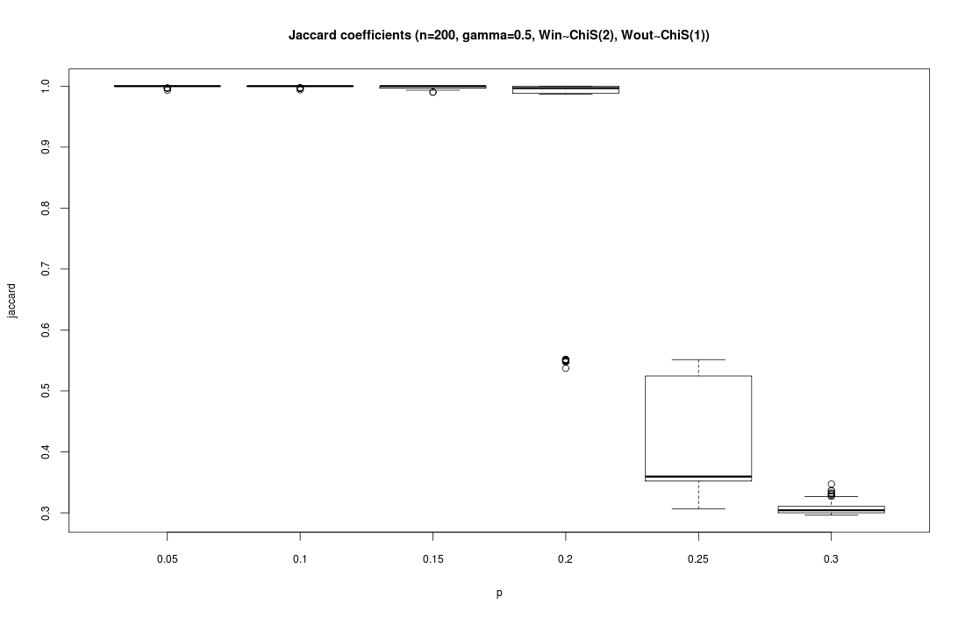
$$w_{out}\sim \left\lceil χ_{1}^{2}\right\rceil$$
$$w_{in}\sim \left\lceil χ_{2}^{2}\right\rceil$$

Slide 52
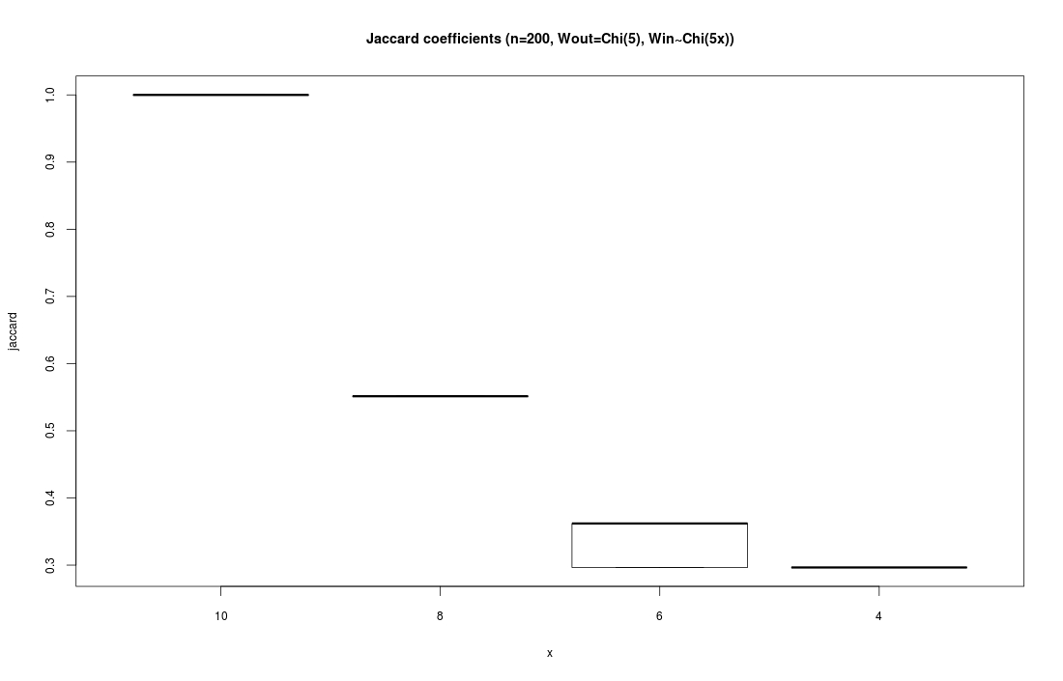
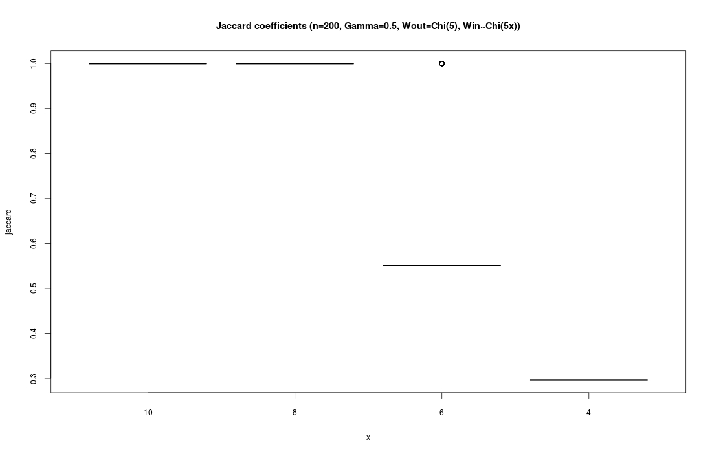
Full graph
$$w_{out}\sim \left\lceil χ_{5}^{2}\right\rceil$$
$$w_{in}\sim \left\lceil χ_{5x}^{2}\right\rceil$$
Notes:
Jaccard coefficients for different weight distributions. In all cases the inter-cluster weights $w_{out}\sim \left\lceil χ_{5}^{2}\right\rceil$. The intra-cluster weight distribution is $w_{in}\sim \left\lceil χ_{5x}^{2}\right\rceil$, where $x$ is the multiplicative factor controlling the mean and variance of the distributions. The left figure present results for $β=γ=0$ and the right for $γ=0.5$. Both algorithms can handle the case where the weights inside are 10 times stronger on average than outside. The $γ=0.5$ version also solves perfectly for 8 fold difference. It also have better results for 6 fold finding the 0.1 and 0.2 clusters. 4 fold weight difference is too hard for both algorithms.

Slide 53
Conclusions
Cohesion improves the definition of density but still inferior to other methods.
Only false positives, no false negatives.
Useful in sparse graphs.
Surprisingly detects smallest cluster.
Susceptible to symmetry.

